Slide 1
CSC3170 Tutorial 4
Haoran Yin
2024.2.27

Slide 2
• 1NF 2NF 3NF BCNF • Functional Dependency Theory • Exercise
Review Tutorial

Slide 3
Definition: Each field is atomic and indivisible. Requirements: Fields cannot be divided, containing only a single value. Every row in the table is unique, with no duplicate rows. Purpose: Ensure basic consistency and independence of data.
1NF

Slide 4
Definition: Builds on 1NF by eliminating partial dependencies of non-primary key fields on the primary key. Requirements: All non-key attributes are fully dependent on the whole primary key. Addresses partial dependency issues of the primary key. Purpose: Further reduce data redundancy and improve the logic of the data structure.
2NF

Slide 5
Definition: Builds on 2NF by eliminating transitive dependencies of non-primary key fields on other non-primary key fields. Requirements: All non-primary key fields are directly dependent on the primary key. No field depends on other non-primary key fields. Purpose: Ensure directness of data dependencies, further optimizing the data structure.
3NF

Slide 6
Definition: An enhanced version of 3NF, addressing dependency issues not solved in 3NF. Requirements: If there are multiple candidate keys with interdependencies, the table must be further decomposed. Every determinant is a candidate key. Purpose: Ensure all dependencies are rational, achieving the optimal data structure.
BCNF

Slide 7
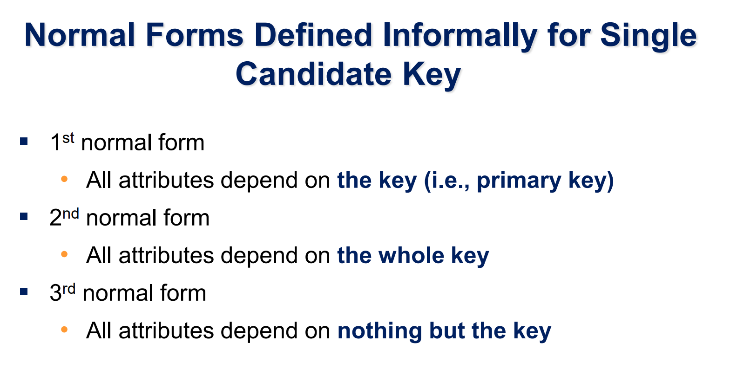

Slide 8
Example.
U={S,T,C} S: Student T: Teacher C: Course
Each teacher only teaches one course
Each course is taught by several teachers
When a student chooses a certain course, he or she has a fixed teacher
When a student takes a course from a certain teacher, the name of the chosen course is determined
Which NF?
S,C,T are all prime attributes
T->C
(S,C)->T
(S,T)->C
(S,C) is key
There is no nonprime attribute
(S,T) is key
At least 3NF
BCNF or not ?

Slide 9
Example.
U={S,T,C} S: Student T: Teacher C: Course
Each teacher only teaches one course
Each course is taught by several teachers
When a student chooses a certain course, he or she has a fixed teacher
When a student takes a course from a certain teacher, the name of the chosen course is determined
Which NF?
S,C,T are all prime attributes
Here T->C
T->C
(S,C)->T
(S,T)->C
(S,C) is key
There is no nonprime attribute
But T is not a key
(S,T) is key
At least 3NF
So this is not a BCNF
BCNF or not ?

Slide 10
Example.
U={S,C,G} S: Student C: Course G: Grade Ranking
Each student chooses multiple courses
Each student has a grade ranking for each course
Each grade ranking of each course corresponds to a student
Which NF?
S,C,T are all prime attributes
(S,C)->G
(C,G)->S
(S,C) is key
There is no nonprime attribute
(C,G) is key
At least 3NF
BCNF or not ?

Slide 11
Example.
U={S,C,G} S: Student C: Course G: Grade Ranking
Each student chooses multiple courses
Each student has a grade ranking for each course
Each grade ranking of each course corresponds to a student
Which NF?
S,C,T are all prime attributes
BCNF:
All the deciding factors are keys
There is no nonprime attribute
(S,C) is key
(S,C)->G
(C,G)->S
At least 3NF
It is BCNF
(C,G) is key
BCNF or not ?

Slide 12
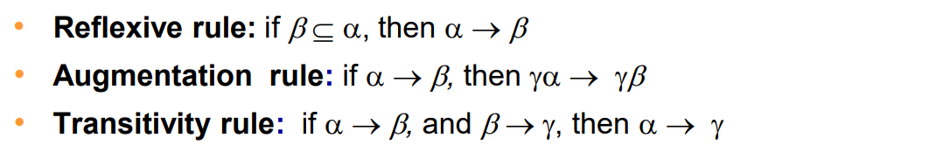
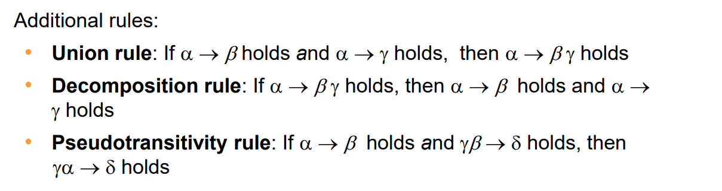
Closure
Armstrong’s Axioms:

Slide 13
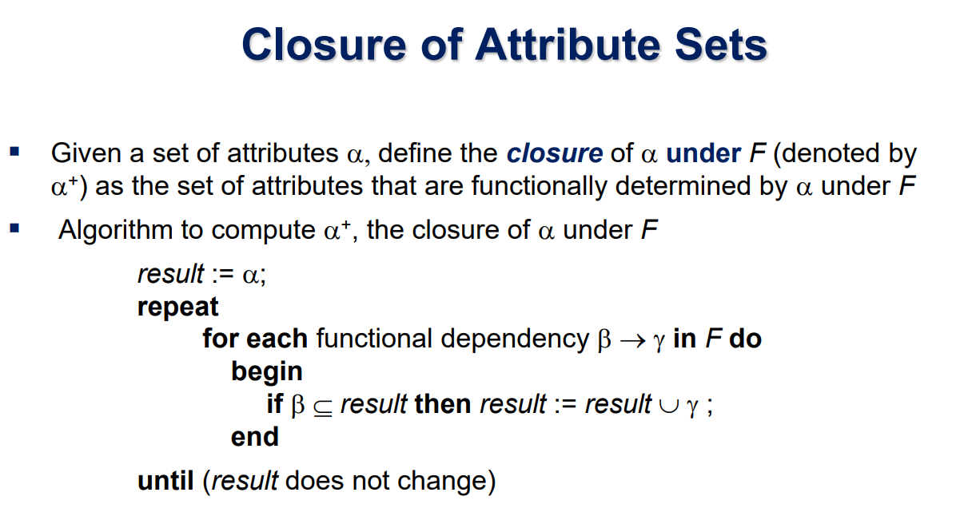

Slide 14
U={A,B,C,D,E,G} F={AB->C, CD->E, E->A, A->G} Find all the candidate keys.
Exercise

Slide 15
U={A,B,C,D,E,G} F={AB->C, CD->E, E->A, A->G} Find all the candidate keys.
Step1:
Classify all attributes
Attributes that must belong to the candidate key:
only appear on the left, or neither appear on the left or right
Attributes that may belong to the candidate key:
both appear on the left and right
Attributes that are not candidate key:
only appear on the right

Slide 16
U={A,B,C,D,E,G} F={AB->C, CD->E, E->A, A->G} Find all the candidate keys.
Step1:
Classify all attributes
Attributes that must belong to the candidate key: B D
only appear on the left, or neither appear on the left or right
Attributes that may belong to the candidate key: A C E
both appear on the left and right
Attributes that are not candidate key: G
only appear on the right

Slide 17




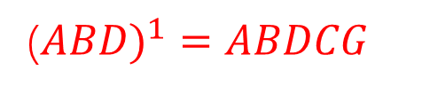











U={A,B,C,D,E,G} F={AB->C, CD->E, E->A, A->G} Find all the candidate keys.
Step2:
Find the closure of the determined attributes.
If the candidate key cannot be formed, then combine the determined attributes and the undetermined attributes, and perform a closure operation until the obtained attributes can deduce all attributes.
$${(ABD)}^{0}=ABD$$
$${(BCD)}^{0}=BCD$$
$${(BDE)}^{0}=BDE$$
$${(BD)}^{0}=BD$$
(${ABD)}^{1}=ABDCG$
$${(BCD)}^{1}=BCDE$$
$${(BDE)}^{1}=BDEA$$
$${(BD)}^{1}=BD$$
$${(ABD)}^{2}=ABDCGE$$
$${(BCD)}^{2}=BCDEA$$
$${(BDE)}^{2}=BDEAGC$$
$${(BD)}_{F}^{+}=BD$$
$${(ABD)}_{F}^{+}=U$$
$${(BCD)}^{3}=BCDEAG$$
$${(BDE)}_{F}^{+}=U$$
$${(BCD)}_{F}^{+}=U$$

Slide 18
U={A,B,C,D,E,G} F={AB->C, CD->E, E->A, A->G} Find all the candidate keys.
Step2:
Find the closure of the determined attributes.
If the candidate key cannot be formed, then combine the determined attributes and the undetermined attributes, and perform a closure operation until the obtained attributes can deduce all attributes.
$$\{\left(ABD\right) , \left(BCD\right) , \left(BDE\right)\}$$

Slide 19
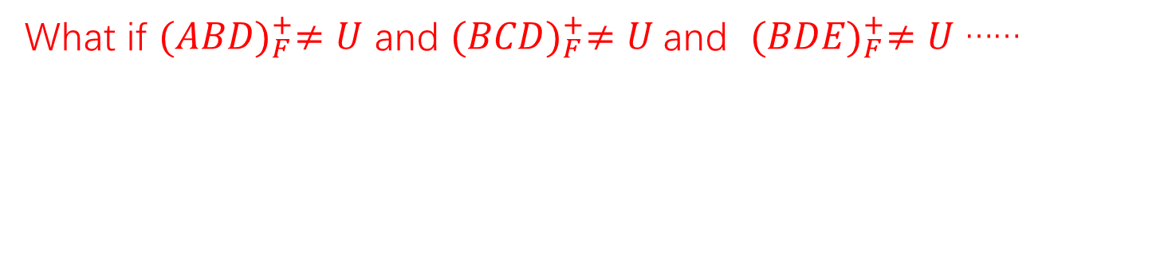

U={A,B,C,D,E,G} F={AB->C, CD->E, E->A, A->G} Find all the candidate keys.
Step2:
Find the closure of the determined attributes.
If the candidate key cannot be formed, then combine the determined attributes and the undetermined attributes, and perform a closure operation until the obtained attributes can deduce all attributes.
What if ${(ABD)}_{F}^{+}≠U$ and ${(BCD)}_{F}^{+}≠U$and ${(BDE)}_{F}^{+}≠U$ ……
Try $\left(BDAC\right)$ $\left(BDAE\right)$ $\left(BDCE\right)$
Notes:
Try $\left(ABDC\right)$ $\left(ABDE\right)$ $\left(AEDC\right)$

Slide 20
Thanks
Haoran Yin
2024.2.27

